Slide 1

Support Vector Machine Algorithm

Slide 2
What is SVM?
A supervised learning algorithm for classification and regression.
Finds the optimal hyperplane to separate data.

Slide 3
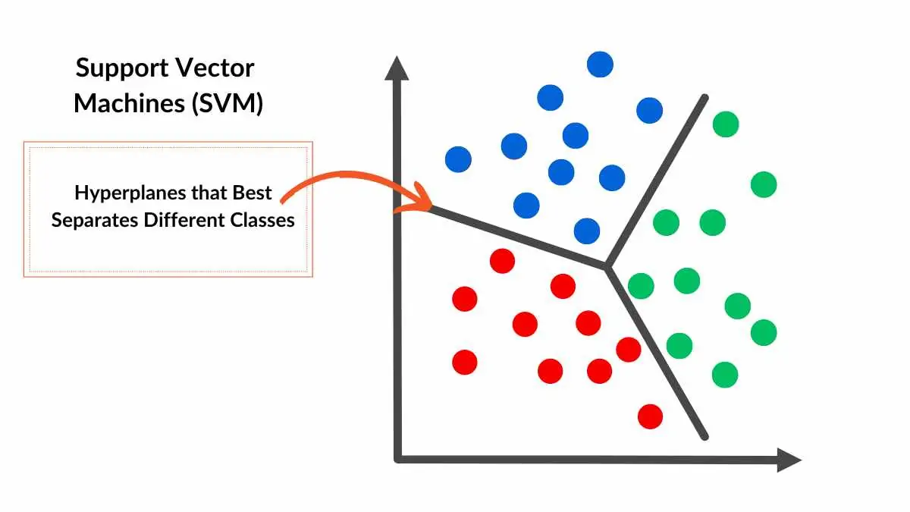
Definition
A Support Vector Machine (SVM) is a supervised machine learning algorithm used for classification and regression tasks. It works by finding the optimal hyperplane that best separates data points into different classes, maximizing the margin between the classes.
SVMs are particularly effective in high-dimensional spaces and can handle both linear and non-linear data using kernel functions.

Slide 4
Margin and Hyperplane
Margin: Distance between the hyperplane and the nearest data points.
Support Vectors: Points closest to the hyperplane.
Linear Classification
Works well when data is linearly separable.
Shows a line dividing two classes (simple 2D example).

Slide 5
Objective of SVM
Maximize the margin
Equation of hyperplane: wTx+b=0
Hard Margin SVM
Assumes perfect separation
No tolerance for misclassification
Used when data is noise-free

Slide 6
Soft Margin SVM
Allows some misclassification using slack variables (ξ)
Balances margin maximization and error minimization
Role of Regularization Parameter (C)
Large C → less tolerance for misclassification
Small C → more tolerance, larger margin

Slide 7
Non-Linearly Separable Data
Not all data can be linearly separated
Need transformation to higher dimensions
Kernel Trick
Uses kernels to map data to higher dimensions
Without computing explicit transformation

Slide 8
Dual Form of SVM
Uses Lagrange multipliers
Enables use of kernels in optimization
(Keep math minimal if audience is non-math.)
SVM in Practice (scikit-learn)
Use sklearn.svm.SVC
python
CopyEdit
from sklearn.svm import SVC
model = SVC(kernel='rbf')
model.fit(X_train, y_train)

Slide 9
Applications of SVM
Text classification
Image recognition
Bioinformatics
Handwriting recognition
Summary
Works for linear and non-linear problems using kernels Powerful for high-dimensional data
SVM maximizes margin between classes

